Slide 1
Final Data Science Presentation
Ananya Gangavarapu

Slide 2
Goals for the project
I intend to find the means to find which stocks are profitable and which stocks aren’t using regression analysis and time series analysis.
With the pandemic and the resultant financial crisis as a result of the stock market crash, it is imperative that in current rise of the market that we find various means in which to buy stocks from companies as well as to see the trends of these stocks.

Slide 3
Data
5 different csv files: fundamental.csv, prices.csv, prices2-adjusted-split.csv, prices3.csv, securities.csv
Fundamental.csv - general information about stocks
Prices.csv (all variants) - high, low, open, close values of stocks.
Securities.csv - All the details about each stock

Slide 4
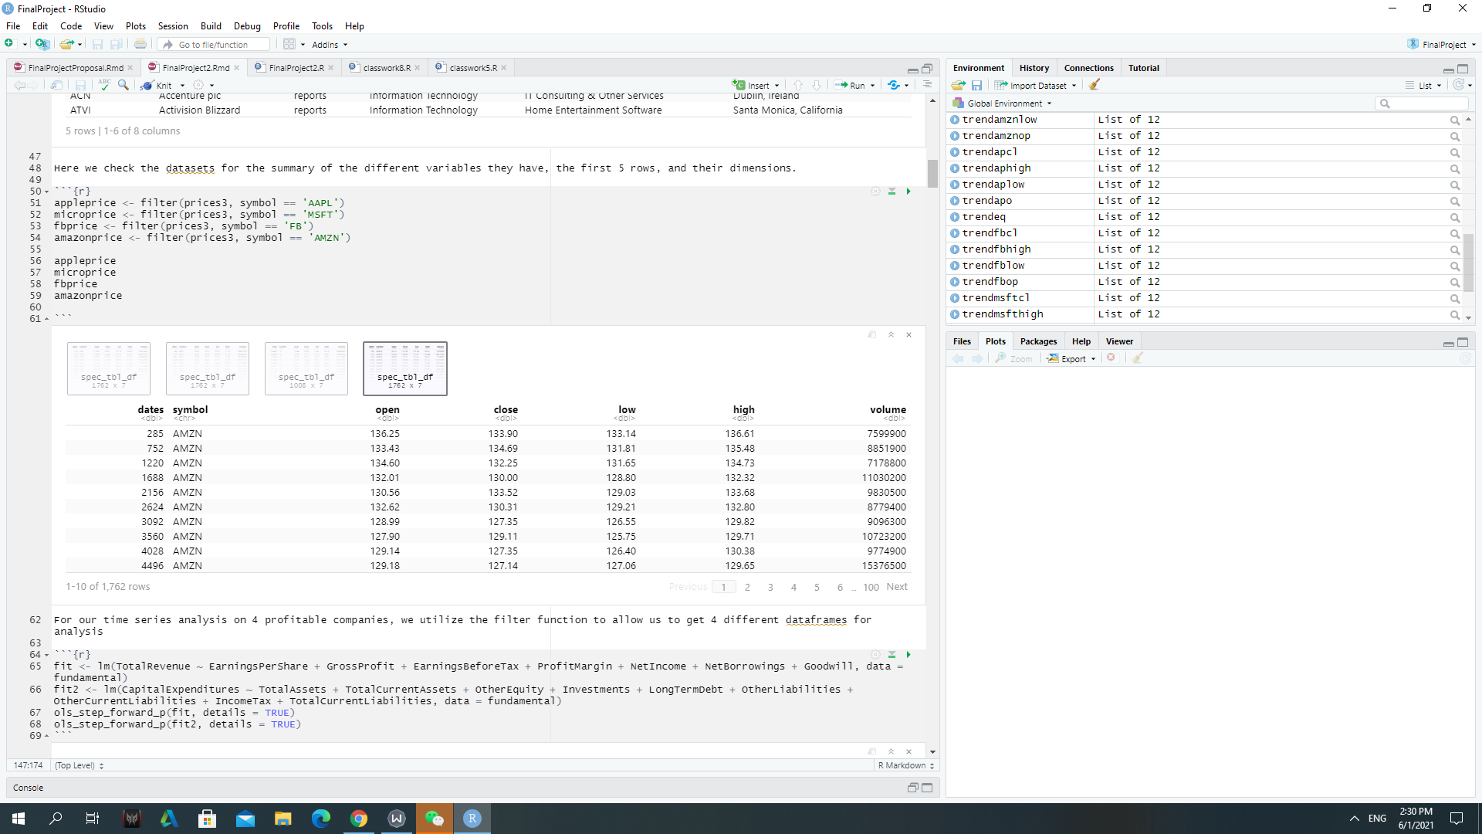
Analysis Done
Generated two models: one for revenue and another for loss
Utilized forward selection for choosing variables
Picked 4 profitable companies and did time series analysis with them: Microsoft, Apple, Facebook, Amazon
Generated Trend Equations for them respectively

Slide 5
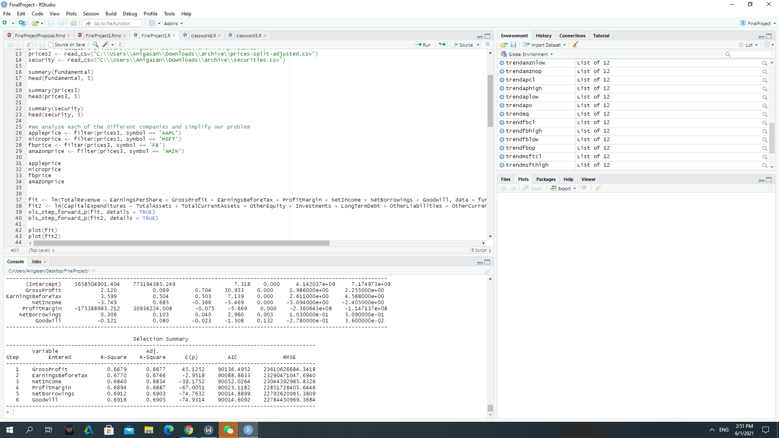
Results

Slide 6
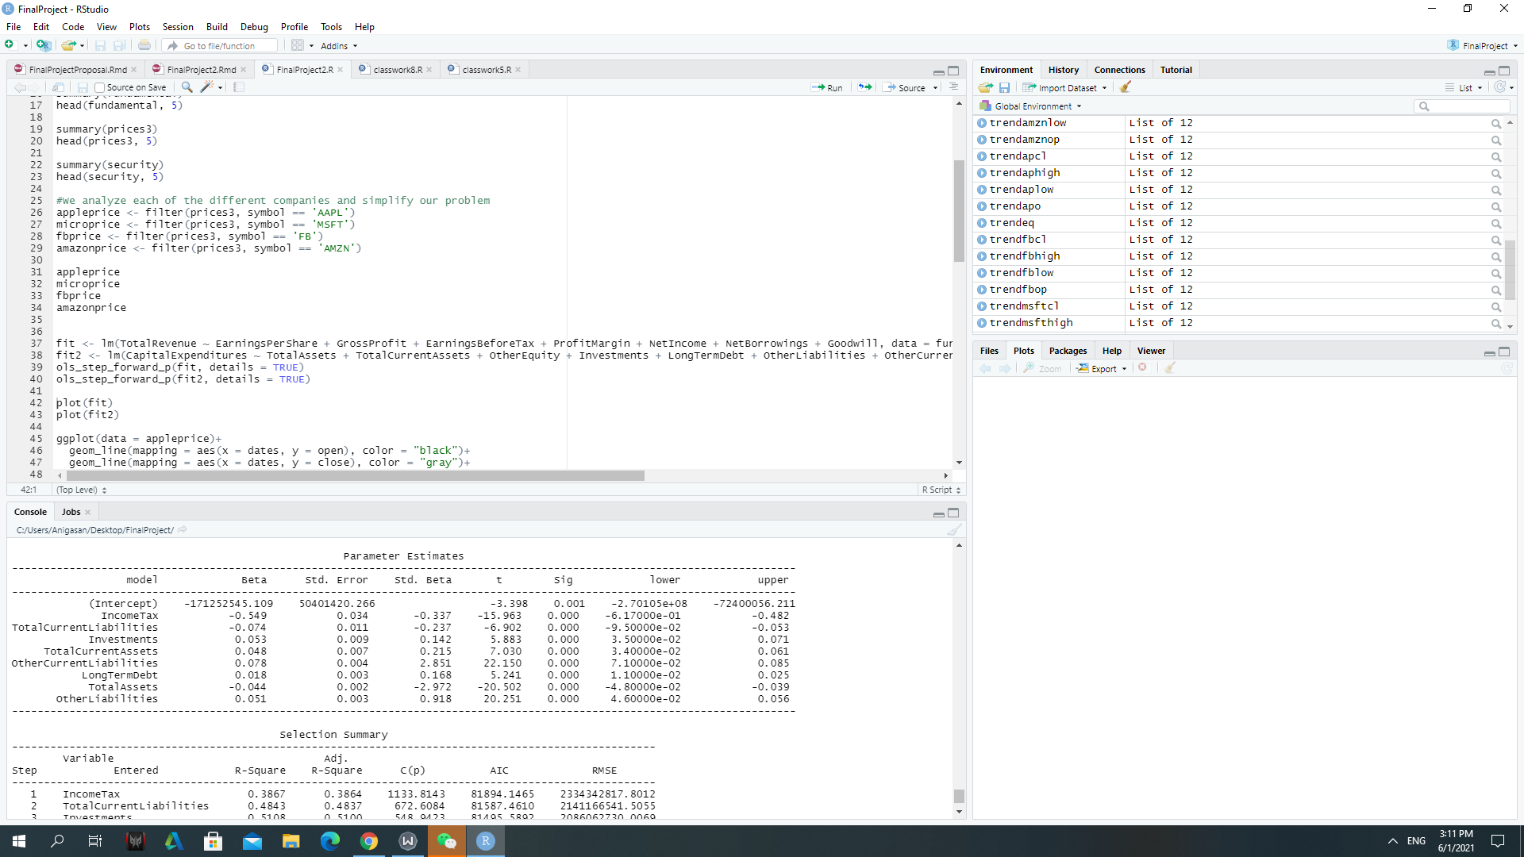
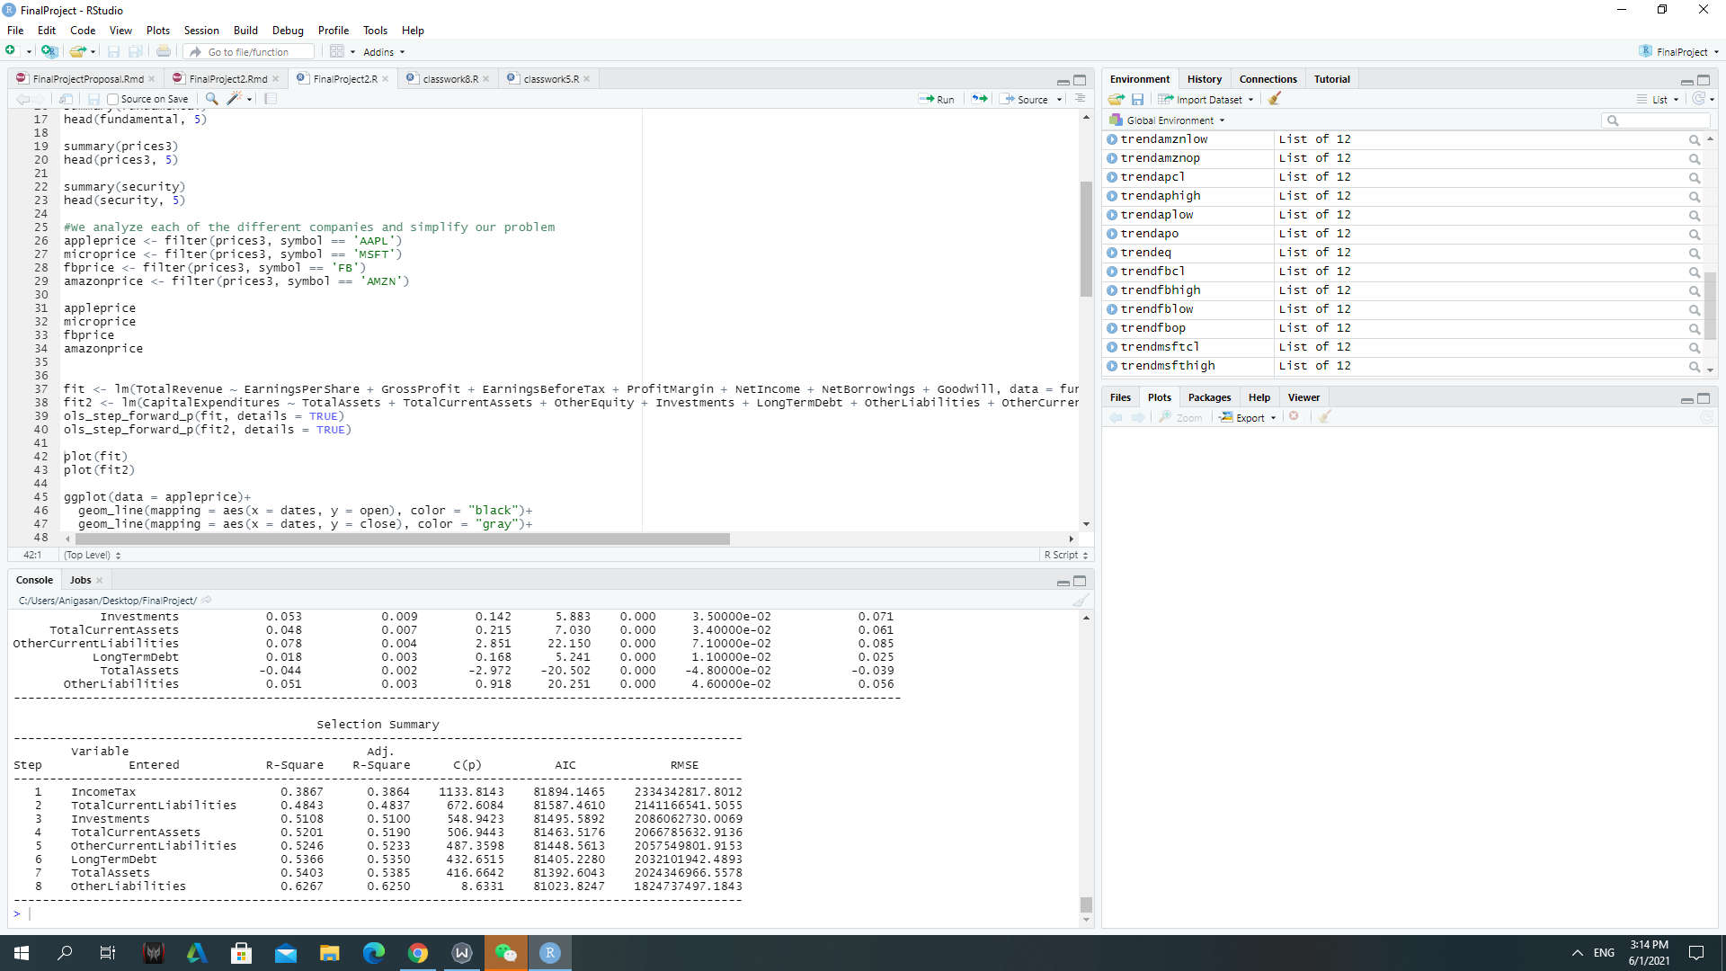
Results

Slide 7
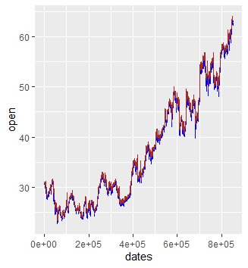
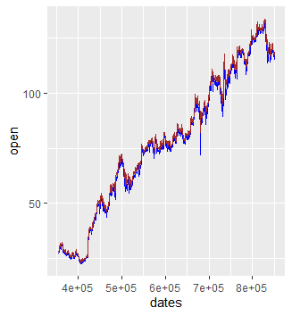
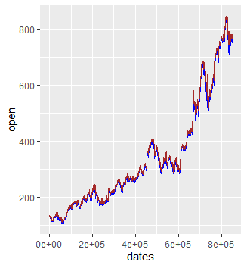
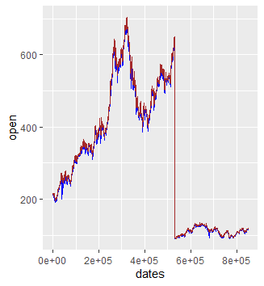
Results

Slide 8
Analysis and Improvement
Forward selection wasn’t most optimal approach, still had lot of error (Best Subsets Regression?)
Was able to get somewhat decent fit thanks to adj-R-squared value
Lot of error within the intercept parameter in both functions.
Apple seemed to plateau in stock price, while Amazon seemed to be consistently the most profitable.
Would try with other various models (Polynomial Regression?)

Slide 9
Thank you!

